Slide 1

Mail Assistant
Sharavana Kumar S
2nd AIDS-C
Syed Faizanullah Bahmani
2nd AIDS-C
Dept of AIDS,
Chennai Institute of Technology, Chennai

Slide 2

Problem Statement
In this fast moving world everyone had their own schedules and targets for which they run for. There is no enough time for us to create a content for the mail. Here Our Mail Assistant helps you to write the mails and send on the behalf of you. On the whole our project provides the way for the users to send mails to your respective receivers.
This site also enables the host to create feedback generator for which every feedback comments will be sent to the host in the form of mail. Our project is the combination of a Mail Assistant and a Feedback Assistant.

Slide 3
Key Features
Generate the content for your mail on different genre such as birthday, permission, leave etc.
After generating the content the content will be sent to the recipient in the form of mail.
Get feedback from others and send the feedback comments to the host in the form of mail.
You can also receive anonymous feedbacks, if you wish that the sender name should be hidden.

Slide 4
Implementation techniques
Mail Assistant works on EmailJs API(Application Programming Interface.
This API provides server engine and incorporated mail engine.
Backend
Javascript
Nodejs
EmailJS Mail Engine.
Frontend
Html
CSS

Slide 5
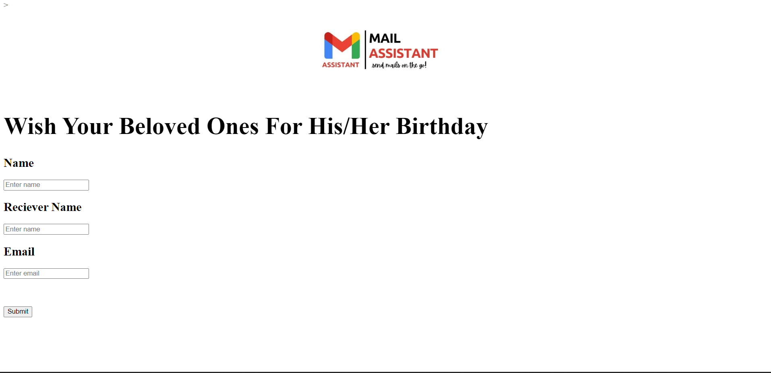
PREVEIW
Sample Input

Slide 6
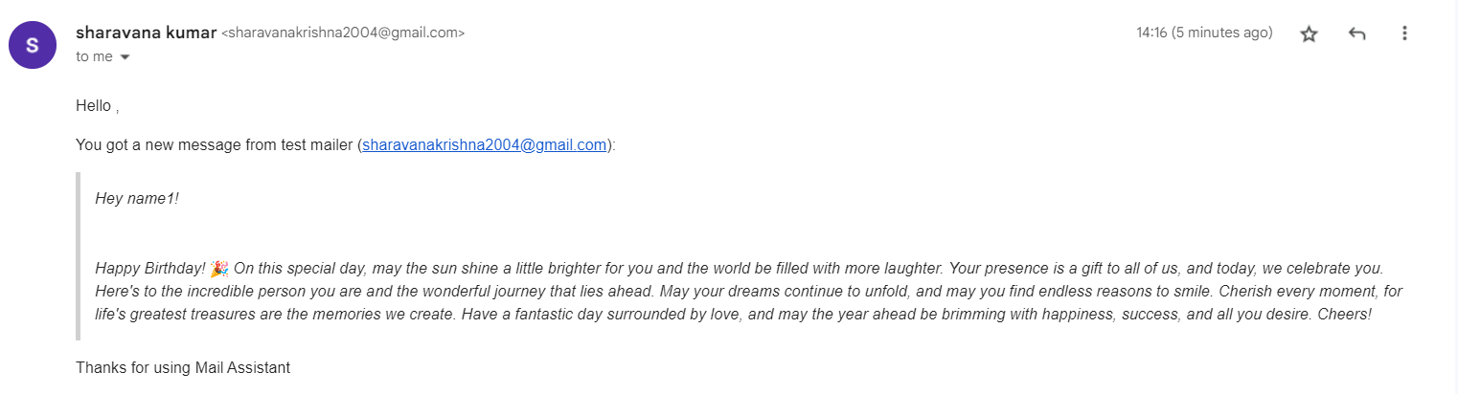
PREVIEW
Sample Mail

Slide 7

Sharavana kumar S
Sharavanakumars.aids2022@citchennai.net
Syed Faizanullah Bahmani
Syedfaizanullahbahmani.aids2022@citchennai.net

